Slide 1
what Information systems will be able to do?
Increasing market share.
becoming the high-quality or low-cost producer.
developing new products increasing employee productivity.
Increasing employee productivity.

Slide 2
Business processes
Business processes are the collection of activities required to produce a product or service.
Every business can be seen as a collection of business processes.
Many business processes are tied to a specific functional area.
For example
the sales and marketing function is responsible for
identifying customers,
–the human resources function is responsible for hiring employees.

Slide 3
Business Processes and Information System
Example of function business processes (company Area)
ex: Garment
Function Area BusinessProcess
Manufacturing and production. Assembling the product & Checking for the quality
Packing Area All Iteams are packing & colleties.
Sales and marketing Identifying the customer and selling the product.
Finance and acconting (accontig department in garment) creating financial statements & Managing cash
account.

Slide 4
simple business process of fulfilling a customer order.
EX : (Daraz online selling)
The sales department receives a sales order.
The order passes first to accounting to ensure the customer can pay for the order. either by a credit verification or request for immediate payment prior to shipping.
A bill or invoice is generated by the accounting department, and a notice is sent to the customer indicating that the product has shipped.
Then the product dipartment send your oder. after that coming your order with the currier.
Then the product has a problem. customer sopported to the (CURRIER).

Slide 5
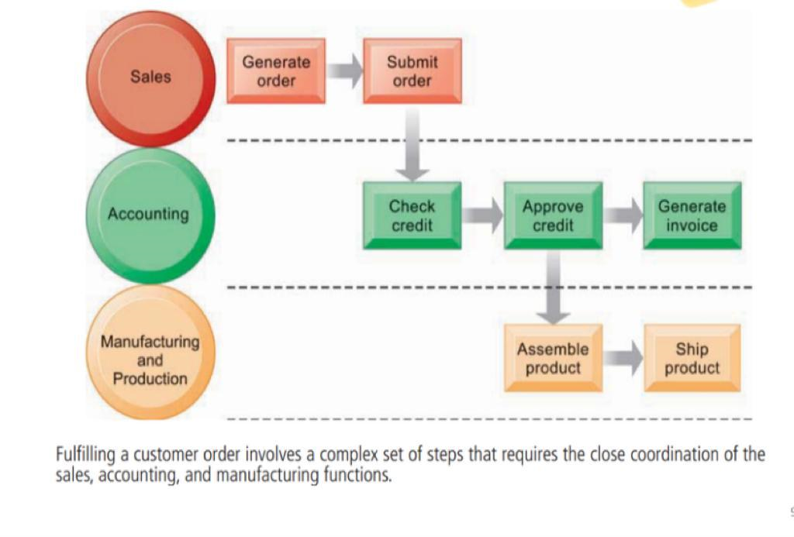
The order Fulfillment process

Slide 6
How to Information system improve business process
Information systems automate many steps in business processes that were formerly performed manually.
If you are going to use it manually, it will be difficult.
EX : In a departmen the system is very difficult to use in manually.
and it is very easy to use when it is systemized.

Slide 7
Types of Information Systems....

Slide 8
Types of Information Systems
Three main categories of information systems serve different organizational levels:
Operational-levelsystems: operational managers, keeping track of the elementary activities and transactions
Management-levelsystems: serve the monitoring, controlling, decision-making, and administrative activities
Strategic-levelsystems:help senior management tackle and address strategic issues

Slide 9
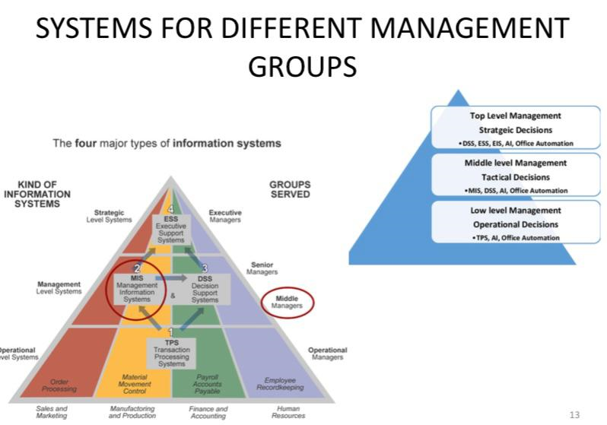

Slide 10
Transaction Processing Systems
keep track of the elementary activities and transactions of the organization.
sales, receipts, cash deposits, payroll, credit decisions, and the flow of materials in a factory.
Performs and records the daily routine transactions necessary to conduct business
sales order entry, hotel reservations, payroll, employee record keeping, and shipping.
Answer routine questions and to track the flow of transactions through the organization.
Eg: How many parts are in inventory? What happened to Mr. Smith’s payment? To answer these kinds of questions

Slide 11
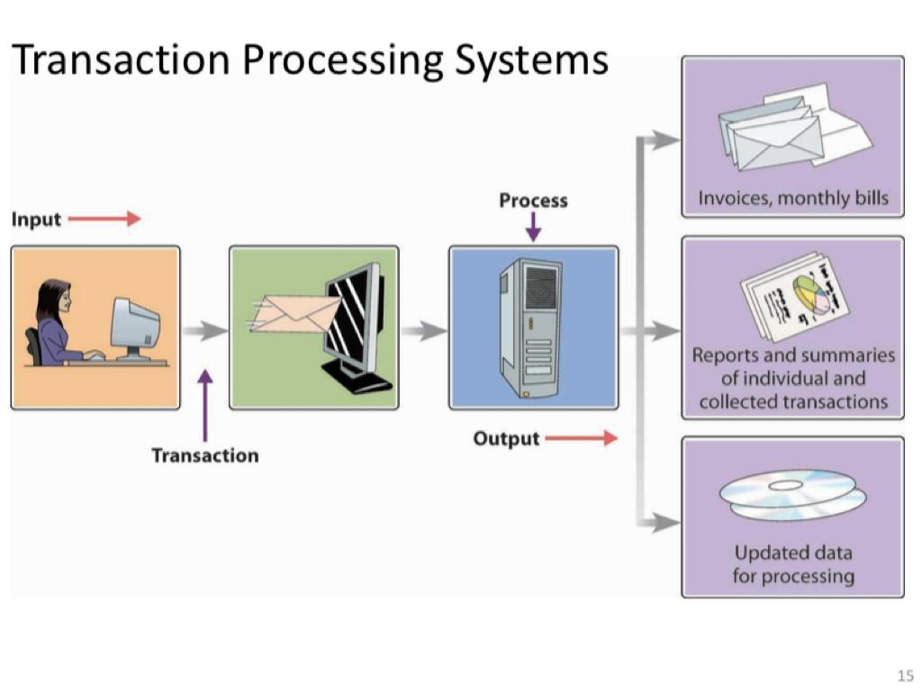

Slide 12
Payroll system
A payroll system keeps track of money paid to employees. An employee time sheet with the employee’s name, social security number, and number of hours worked per week represents a single transaction for this system. Once this transaction is input into the system, it updates the system’s master file that permanently maintains employee information for the organization. The data in the system are combined in different ways to create reports of interest to management and government agencies and to send paychecks to employees.

